Slide 1
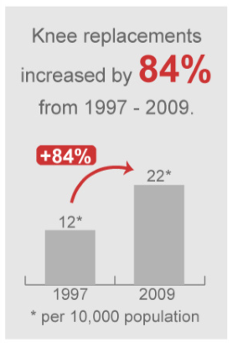
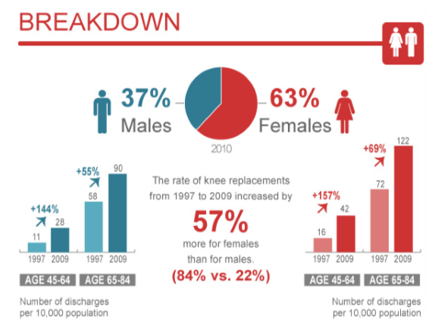
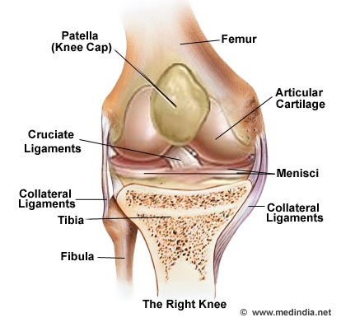
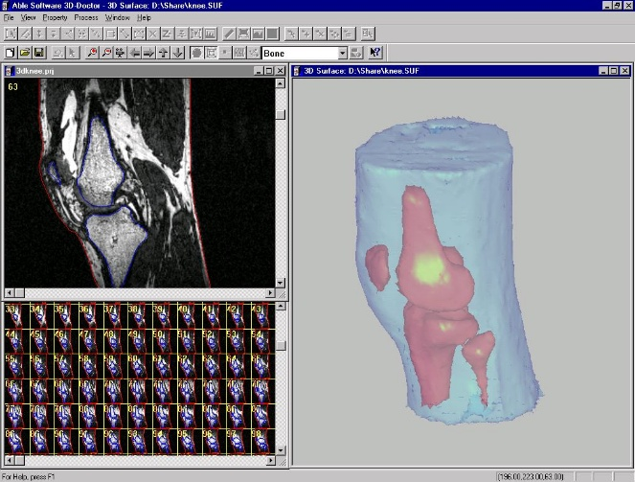
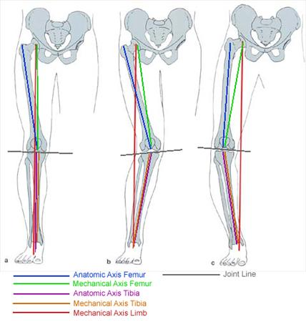
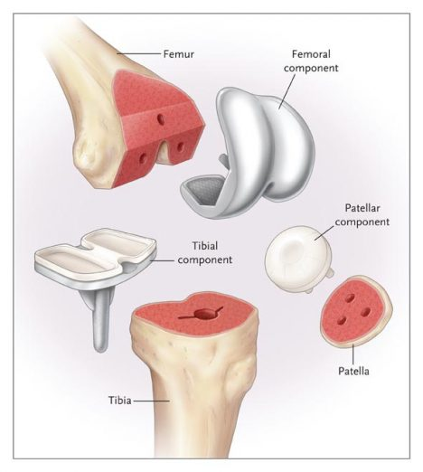
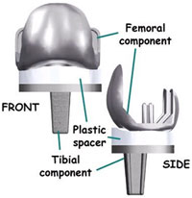
Low Cost Indigenous Patient Specific Solution for Total Knee Replacement(Arthroplasty)
Aditya Ranjan, Manish Kumawat, Manpreet Singh Bedi, Siddarth Jain
Under Supervision of : Dr. B. Ravindra , Dr. Gaurav Harit
External Supervisor: Dr. Abhay Elhence(AIIMS,Jodhpur)
Motivation: cost that brings you down to your knees
Dimensions: Impact sectors
Methods and procedures
ddkddk
Knee Replacement was the 14th most common in-patient procedure in 2009.
The fact that 15% of the Indian population suffers from this crippling issue is alarming and it deserves immediate attention.
In India, Arthritis which affects the knee is more prevalent in the country with every third person above the age of 70 years facing the same.
India has the second largest knee-osteoarthritis patient base around the world.
Start
Background Research & Analysis
Collecting relevant information
Internet
Research Papers
Journals
“More than 15,000,000 Indians are affected from knee related issues every year.”
Input Data Acquisition
MRI image Segregation
Feature point extraction
Epipolar geometry
Camera Calibration
Projecting reconstruction
Affine reconstruction
Euclidian reconstruction
3-D Modelling
Dense-Depth matching
Model construction
Significance and Importance
Health experts believe the high cost of imported knee implants makes the option of a knee-replacement surgery out of the reach of the middle class.
Doctors and hospitals pocket large profits on the implants — for instance, the import price of a complete knee-replacement kit is only Rs 37,554, but customers are asked to pay at least Rs 1.11 lakhs.
People who are more than 65 years old are most likely to require knee replacement surgery, but they do not have insurance cover. Even among the three out of ten who do, the amount insured is rarely more than two lakhs.
Social and economic inequality is detrimental to the health of any society. Especially when the society is diverse, multicultural, overpopulated and undergoing rapid but unequal economic growth.
Stress Analysis
Identifying mechanical load bearing axis using critical centers
Study of 3-D model under varying loading conditions using an analysis software.
Critical Centers Calculation
Bubble Container Algorithm
Approximation of Femur and Tibia axis Centers.
Measurement of Deviation in Mechanical axis
Determination of femoral and Tibial cut axis.
Preparing Computer Assisted Patient Specific Jigs for Mechanical Axis Alignment in Total Knee Arthroplasty
The development of innovative indigenous ‘Patient Specific’ joint replacement technologies, would not only make this health care service extremely affordable for various segments of the society, but also ensure more efficient treatment.
Finish
TIMELINE dIAGRAM
Expected results
References
Correction of deformities and optimal balancing of soft tissues.
Achievement of functional joint motion and stability.
Satisfactory alignment in the frontal, sagittal and horizontal planes.
http://iol.ie/~rcsiorth/journal/volume2/june/mech.htm
http://www.orthobullets.com/recon/5014/mechanical-alignment-in-tka
http://www.boneandjoint.org.uk/content/focus/alignment-total-knee-replacement
http://www.ncbi.nlm.nih.gov/pubmed/22340552
http://www.malzer.homepage.t-online.de/HomepageClassic01/english/offen/medizin/align/alipuben.htm
Parameter | Before | After
Estimated Cost | Rs. 5-6 Lac | Rs. 4.5-5.5 Lac
Approximate Time | 4-6 weeks | 2-3 weeks
Reduction in cost
Rs. 50-60 K (aaprox.)

